Slide 1
3.4.12 - 17/09/2020 15h15
Hackathon Aquafin Challenge
----
Predicting pump failures based on sensor data of pump stations
----
Data-Visualisation using Co-Occurrence Matrix
Elodie TOUFAILI
R&D engineer – PhD student
CARL SOFTWARE – Berger Levrault Group
Sébastien DUFOUR
Data scientist
CARL SOFTWARE – Berger Levrault Group
Copyright © 2020 by <enter author(s) and/or organization.> All rights reserved.
This presentation or any portion thereof may not be reproduced or used in any manner whatsoever without the express written permission of the author or rights holder.

Slide 2
Objective – Works and Method
Our Objective :
Clearly identify elements of measurement that would make it possible to prediction a future breakdown (with a 7-day in advance objective)
Method :
Understand the global functioning : Pumping cycle, links to the water level, use of multi-pumps / Correlation between failures and Flow / Intensity data measures
Exploratory Data Analysis : Use various Machine Learning methods: Principal Component Analysis - Statistics - Supervised Classification Algorithms - Data Visualization to identify failures
First level of Conclusions
Work done on basis of data from only 2 pumping stations / 4 : 1003 -1911

Slide 3
Data pre-processing surveyed station 1003 then 1911
Preprocessing to organise data in operating episodes :
- Start Timestamp / Episode interval / Water Level and Running time
- Statistics elements : Debit average or estimated quantity of water delivered /
current intensity
ALLOW
Understand operation cycle and Multi pumps use
Knowledge of the range of measures in regular conditions to evaluate behavior drifts
Links to the remarkable episodes (non-standard data, not operating pump) to the maintenance sheet
Observe what happened before this episode

Slide 4
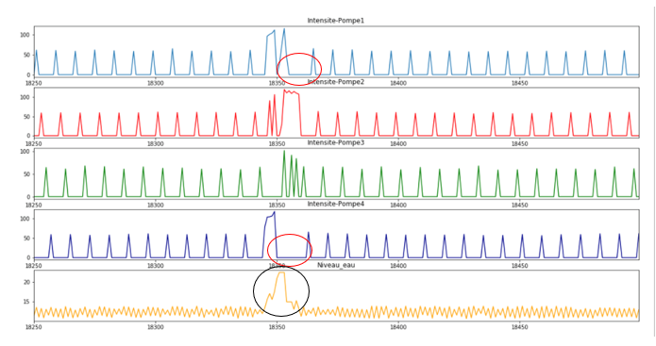
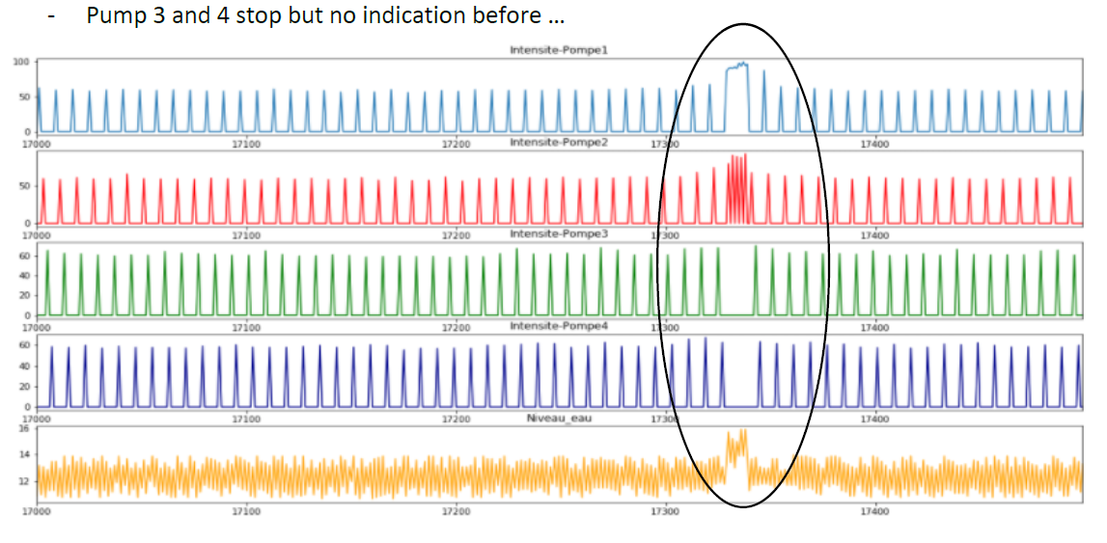
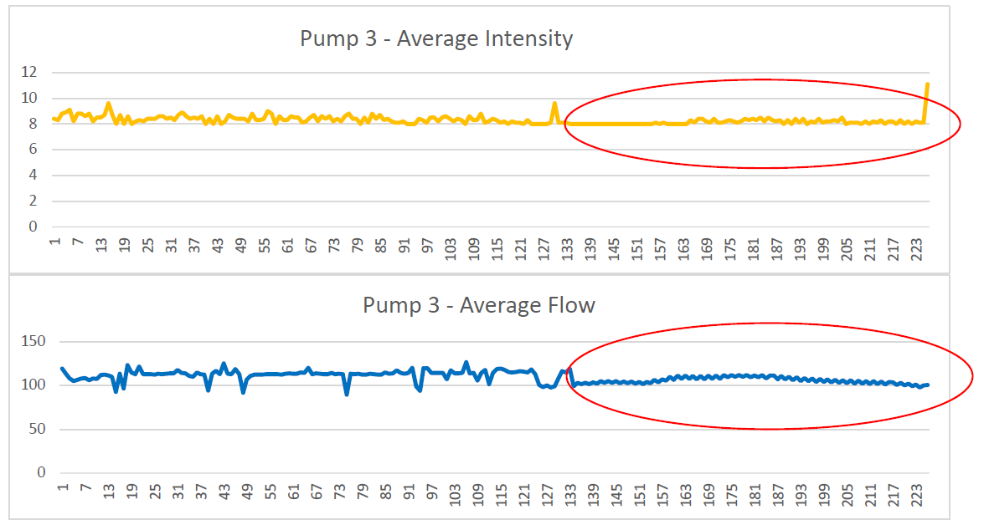
Incidents examples
1003 - Pump 1 and 4 stop / Limit reached in intensity 125A
30/01/2019
Flow is low
Current stable
Change in behavior
04/04/2019 : Decrease in flow while intensity stays stable

Slide 5
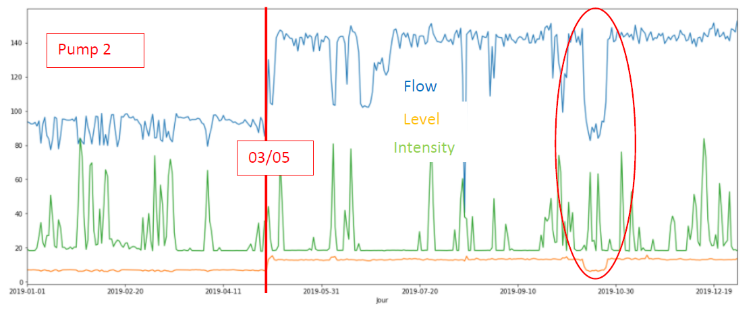
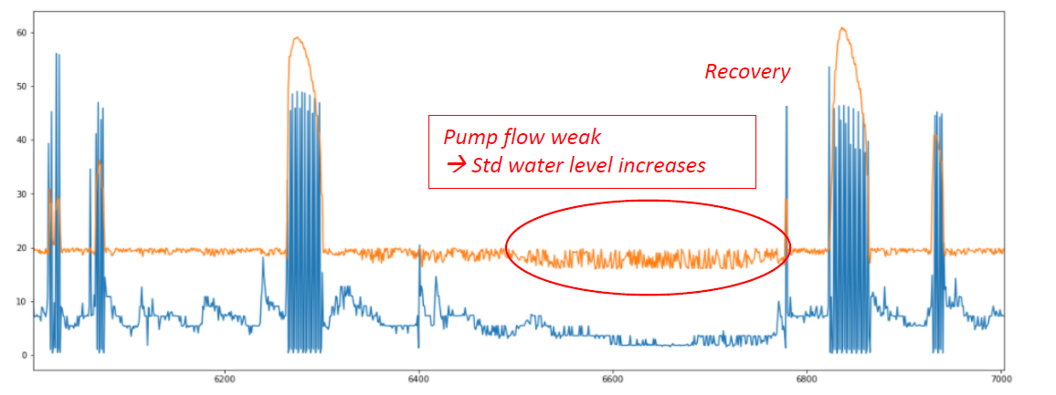
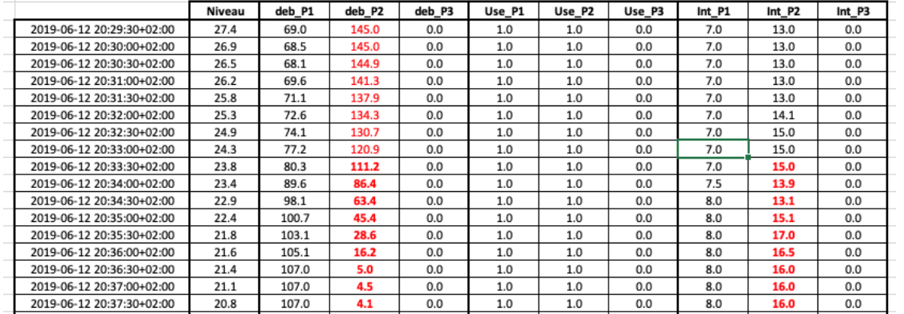
Correlation between water level and pump flow :
Level increases→ More flow
Pump flow weak, standard deviation increases
PCA and EDA show a big change in pump 2 behaviour on third of May and then in october. Flow increases 100 → 140
Why ? Not solved by the maintenance sheet
Pump 3 – station 1911
Net overcurrent

Slide 6
EDA - Conclusion
Identify every episode where a pump is in failure state with anomaly detection methods
Looking at the data of the previous 7 days :
Too few significant elements to interpret that a mechanical failure will occur.
Possible to envisage the imminence of a failure : Changes in the general behavior
Stops seem to be the result of a simple problem of flow blockage (fouling at the inlet)
Most of the failures appear while the water level is high in the pumping station
But, we have to deplore in this case many false positives
--> Risk of false alarms important - result is not completely satisfactory

Slide 7
Cooccurrence matrices
Way of representing discretized data, count the number of values corresponding to a pair of classes
What is it ?
Why ?
Results on the Aquafin dataset

Slide 8
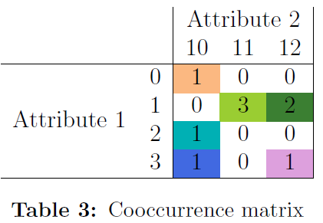
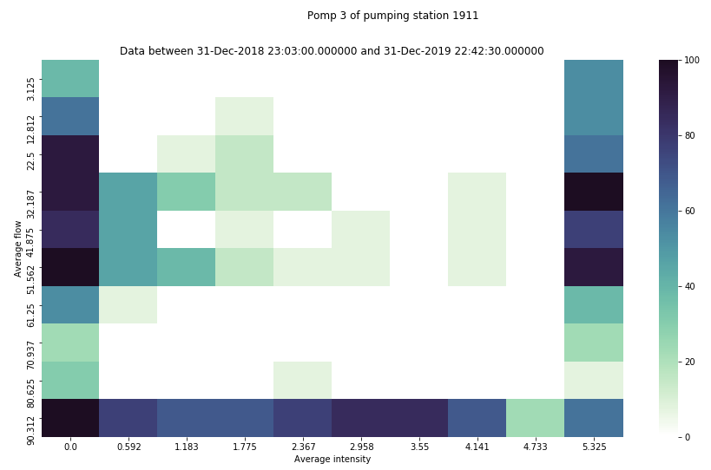
Cooccurrence matrices - What is it ?

Slide 9
Cooccurrence matrices – Why ?
Visualize data dynamically (videos) :
dividing time series into time windows
comparison between the matrices of the different time windows
Study the relationships between a pair of attributes (trends, patterns, ...)
Identify drifts from usual behaviour
Easily understandable process for uninitiated people

Slide 10
Cooccurrence matrices - Results

Slide 11
Elodie TOUFAILI
00 33 4 26 29 49 49
R&D engineer – PhD student
elodie.toufaili@carl.eu
CARL SOFTWARE – Berger Levrault Group
Sébastien DUFOUR
00 33 4 26 29 49 49
Data scientist
sebastien.dufour@carl.eu
CARL SOFTWARE – Berger Levrault Group
Copyright © 2020 by <enter author(s) and/or organization.> All rights reserved.
This presentation or any portion thereof may not be reproduced or used in any manner whatsoever without the express written permission of the author or rights holder.

